Slide 1
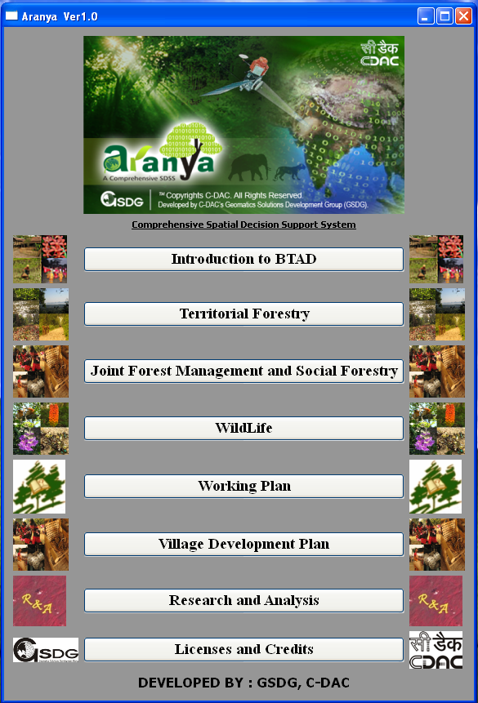

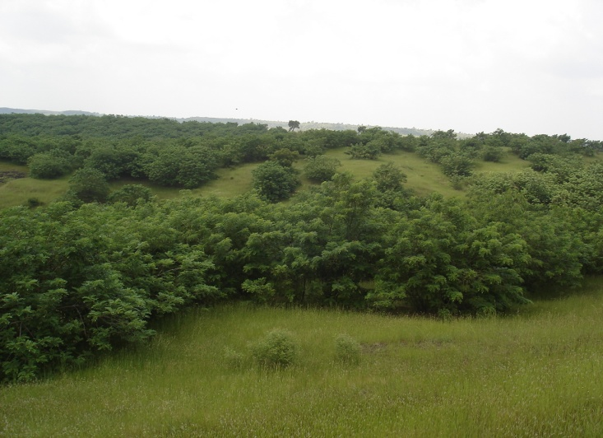
ARANYA
Comprehensive Spatial Decision Support System
Effective for…..
Land Allocation for Working Plans
Growing Stock Estimation
Village Development Planning
Forest Village Micro-planning
Tree Carbon Estimation (Carbon Calculator)
Habitat Suitability
Introduction to BTAD
Territorial Forestry
Joint Forest Management and Social Forestry
Wildlife and Biodiversity
Tools For Performing Query On
Forest Crimes
IUCN based Species Inventory
Compartment History
Working Plan
Village Development Plan
Research and Analysis
Licenses and Credits

Slide 2
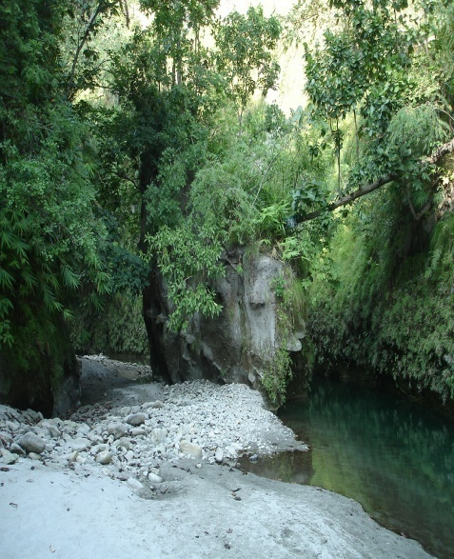

ARANYA
Comprehensive Spatial Decision Support System
Information On
Forest types
Wild life
Population
Socio-economic profile
Natural resources
Introduction to BTAD
Territorial Forestry
Joint Forest Management and Social Forestry
Wildlife and Biodiversity
Working Plan
Village Development Plan
Research and Analysis
Licenses and Credits

Slide 3
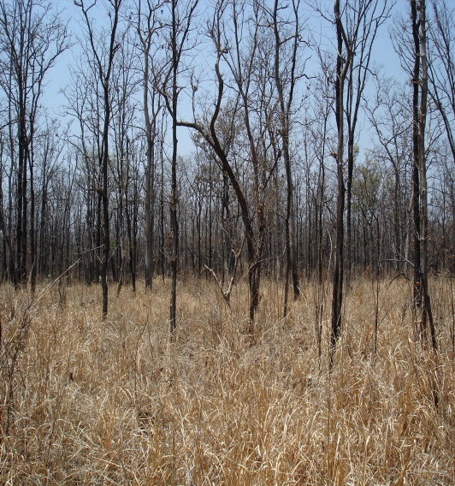
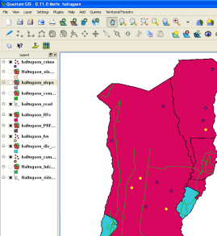
ARANYA
Comprehensive Spatial Decision Support System
Query on Forest Crimes
Analyzing Forest Crime patterns
Proximity analysis for identification of new camp locations to reduce forest crimes
Introduction to BTAD
Territorial Forestry
Joint Forest Management and Social Forestry
Wildlife and Biodiversity
Working Plan
Village Development Plan
Research and Analysis
Licenses and Credits
Poaching locations

Slide 4
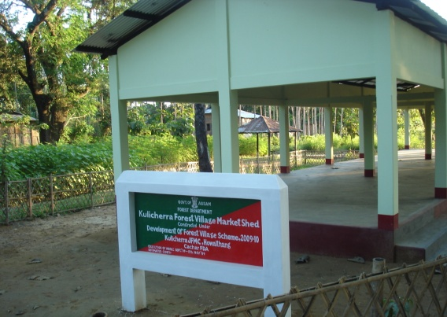
ARANYA
Comprehensive Spatial Decision Support System
Joint Forest Management and Social Forestry
Introduction to BTAD
Plantation Inventory based on Division, Type & Year
Forest Village Micro-Planning
Territorial Forestry
Joint Forest Management and Social Forestry
Wildlife and Biodiversity
Working Plan
Village Development Plan
Research and Analysis
Licenses and Credits

Slide 5
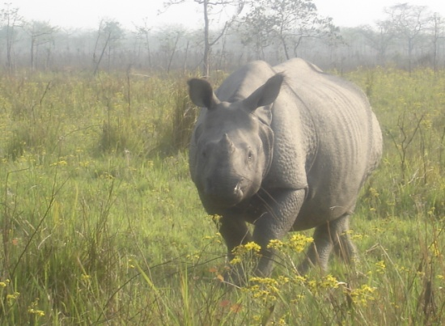
ARANYA
Comprehensive Spatial Decision Support System
Wildlife Habitat Suitability
Introduction to BTAD
Protected Area Planning
Multi-criteria Analysis
Territorial Forestry
Joint Forest Management and Social Forestry
Wildlife and Biodiversity
Working Plan
Village Development Plan
Research and Analysis
Licenses and Credits

Slide 6
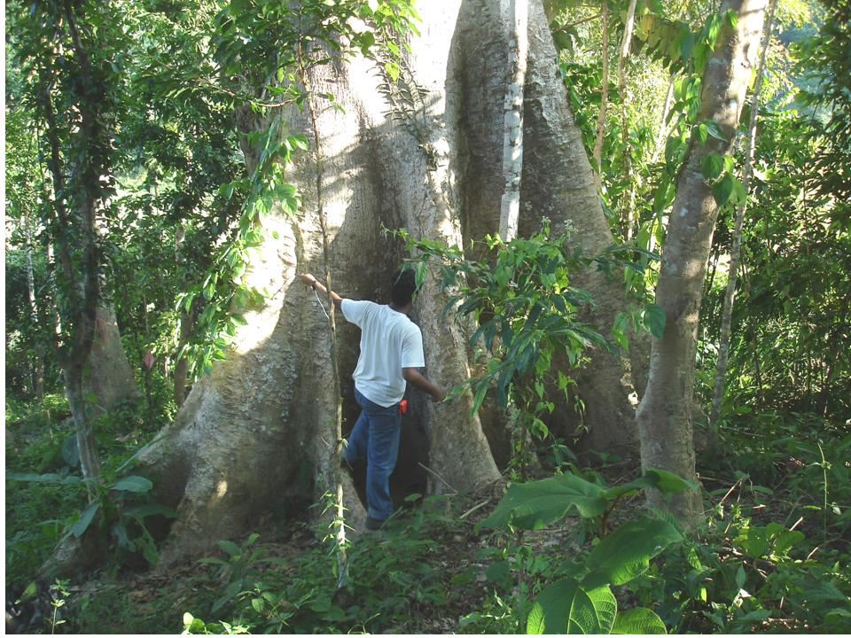
ARANYA
Comprehensive Spatial Decision Support System
Working Plan
Land allocation to different working circles based on user-defined criteria(eg. plantation, conservation, etc.)
Growing Stock Estimation
Searching for species within compartments based on IUCN status
Introduction to BTAD
Territorial Forestry
Joint Forest Management and Social Forestry
Wildlife and Biodiversity
Working Plan
Village Development Plan
Research and Analysis
Licenses and Credits

Slide 7
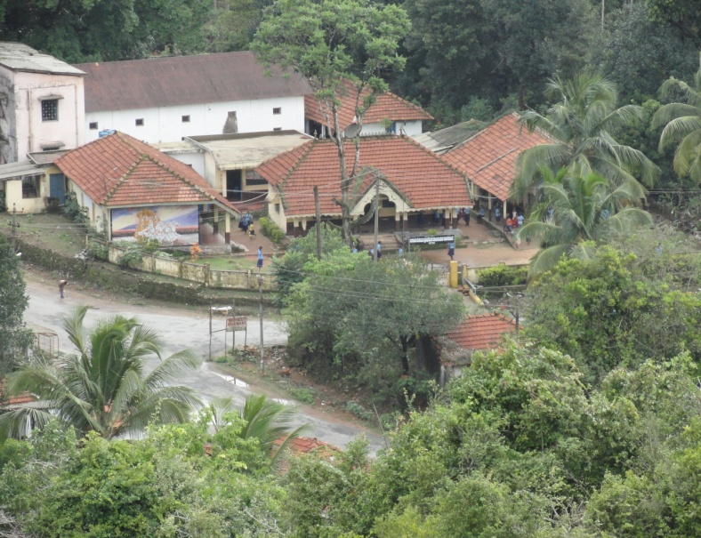
ARANYA
Comprehensive Spatial Decision Support System
Village Development Plan
Introduction to BTAD
Finding suitable places for relocation of forest villages
Factor such as Facilities (Medical, Education, Bank), Slope, Land use, Ground water potential considered for relocation
Territorial Forestry
Joint Forest Management and Social Forestry
Wildlife and Biodiversity
Working Plan
Village Development Plan
Research and Analysis
Licenses and Credits

Slide 8
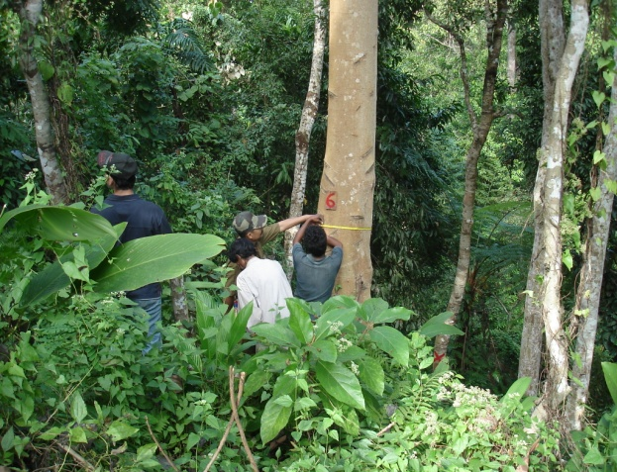
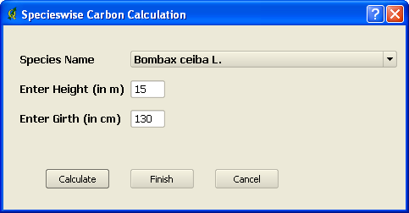
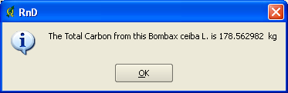
ARANYA
Comprehensive Spatial Decision Support System
Research and Analysis
Carbon Calculator based on species height and girth
Viewing files on Google Earth
Introduction to BTAD
Territorial Forestry
Joint Forest Management and Social Forestry
Wildlife and Biodiversity
Working Plan
Carbon Calculator
Village Development Plan
Research and Analysis
Research and Analysis
Licenses and Credits

